Slide 1
FLAVA
A Foundational Language And Vision Alignment Model

Slide 2
Outline
Introduction
Flava Model Architecture
Pre-Training Tasks
Other Vision and Language Models
Results
Conclusion
References

Slide 3

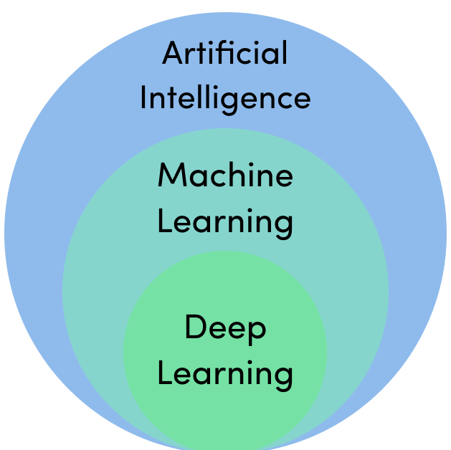
Introduction
Foundational Language And Vision Alignment Model (FLAVA)
Paper released in 2021 by Facebook AI Research Team
Code to be released in 2022 under torchvision
Language vision alignment model that learns strong representations from multimodal data (image-text pairs) and unimodal data (unpaired images and text)

Slide 4
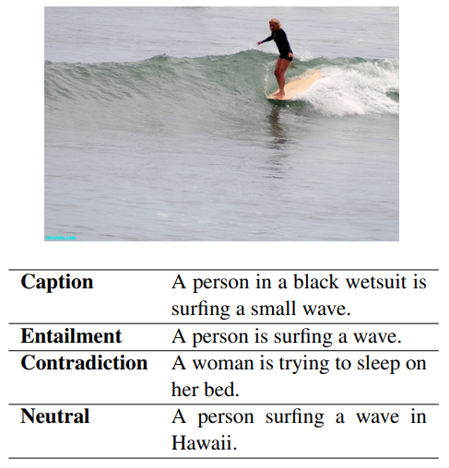
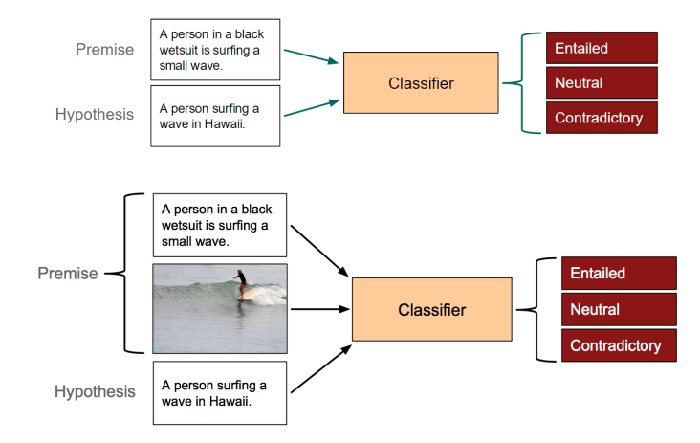
Introduction - Tasks
There are several categories of tasks which span across modalities:
Unimodal Vision Tasks ( Image)
Object Identification/Facial Recognition
Image Segmentation
Image Classification
Unimodal Language Tasks (Tex)
Natural Language Inference
Sentiment Analysis
Named Entity Recognition
Multimodal Tasks (Image + Text)
Image-Text Matching
Visual Question Answering (VQA)
Multimodal Natural Language Inference (MNLI)
Figure: An example of the data given in the SNLI dataset, with the associated image from the Flickr30k dataset

Slide 5
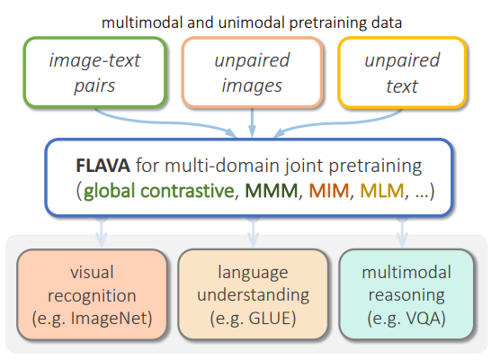
Introduction - FLAVA
State-of-the-art models are often either cross-modal (contrastive) or multi-modal (with earlier fusion) but not both; and they often only target specific modalities or tasks.
FLAVA targets all modalities at once – a true vision and language foundation model good at vision tasks, language tasks, and cross- and multi-modal vision and language tasks.
FLAVA demonstrates impressive performance on a wide range of 35 tasks spanning these target modalities (visual recognition, language understanding, and multimodal reasoning).
FLAVA uses a Transformer Architecture

Slide 6
Flava Model
The FLAVA model core is composed by:
an image encoder transformer to capture unimodal image representations
a text encoder transformer to process unimodal text information
a multimodal encoder transformer that takes as input the encoded unimodal image and text and integrates their representations for multimodal reasoning
For downstream tasks:
classification heads are applied on the outputs from the image, text, and multimodal encoders respectively for visual recognition, language understanding, and multimodal reasoning tasks.

Slide 7
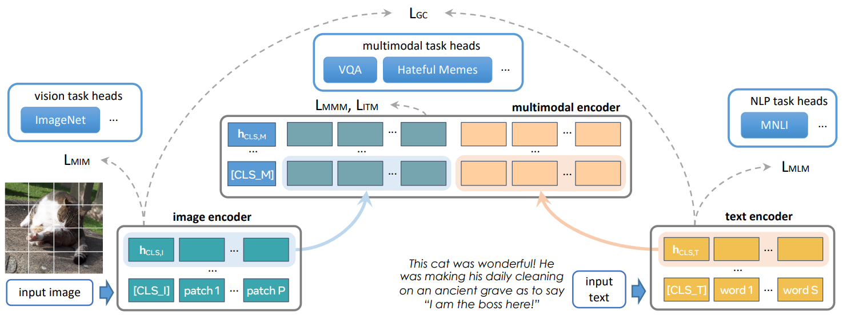
Flava Model
Figure: Overview of the FLAVA model

Slide 8
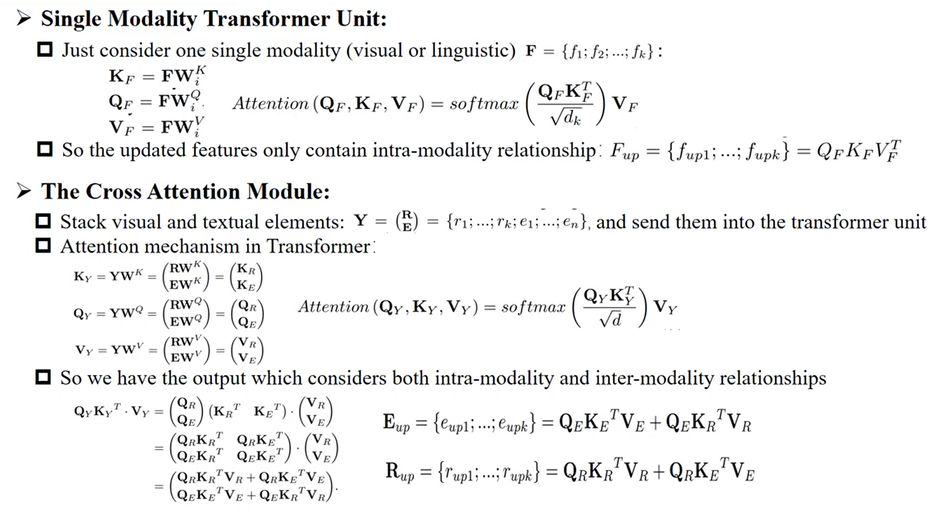
Attention VS Self-Attention

Slide 9
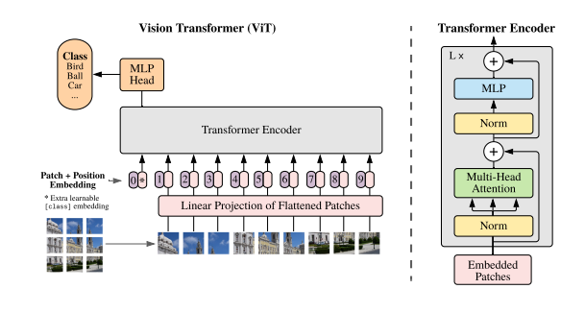
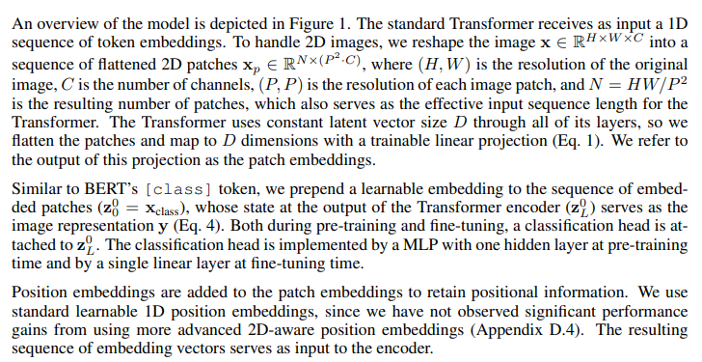
Vision TransfoRmer ViT-16
Model overview:
Split an image into fixed-size patches, linearly embed each of them and add position embeddings
feed the resulting sequence of vectors to a standard Transformer encoder
In order to perform classification, the standard approach is based on adding an extra learnable “classification token” [CLS] to the sequence

Slide 10
Vision Transformer
In this model, each spatial location builds its representation by “attending” to the other locations.
By “looking” at other, potentially distant pieces of the image, the network builds a rich, high-level understanding of the scene.
When visualizing the local attention maps in the network, we see that they correspond to coherent semantic regions in the image.

Slide 11
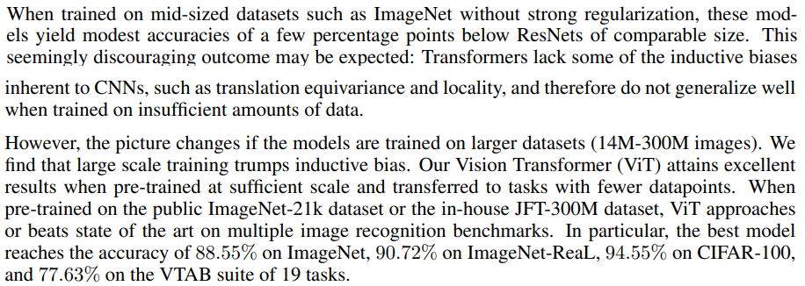
Vision Transformers vs CNNs
The inductive bias (also known as learning bias) of a learning algorithm is the set of assumptions that the learner uses to predict outputs of given inputs that it has not encountered.
The Vision Transformer has much less image-specific inductive bias than CNNs.
In CNNs, locality, two-dimensional neighborhood structure, and translation equivariance are baked into each layer throughout the whole model.
In ViT, only MLP layers are local and translationally equivariant, while the self-attention layers are global.
The position embeddings at initialization time carry no information about the 2D positions of the patches and all spatial relations between the patches have to be learned from scratch.

Slide 12
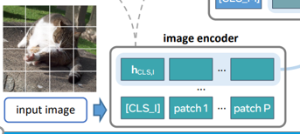

Flava Model - Image Encoder
The ViT-B/16 architecture is adopted for the image encoder.
Given an input image:
the image is resized to a fixed size
the image is split into patches
The patches are linearly embedded and fed into a transformer model (along with positional embeddings and an extra image classification token$\left[CLS_I\right]$).
The image encoder output is a list of image hidden state vectors ${\{h}_{I}\}$, each corresponding to an image patch, plus an additional $h_{CLS,I}$ for $\left[CLS_I\right]$.

Slide 13
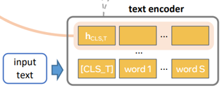

FLAVA Model - Text Encoder
Given an input piece of text (e.g., a sentence or a pair of sentences):
The sentence is first tokenized
The sentence is embedded into a list of word vectors.
Then, a transformer model is applied over the word vectors to encode them into a list of hidden state vectors $\{h_{t}\}$, including $h_{CLS,T}$ for the text classification $[CLS_T]$ token.
Importantly, different from prior work, the text encoder has exactly the same architecture as the visual encoder.
The same Transformer architecture is used (but with different parameters) for both the visual and textual encoder, based on ViT-B/16.

Slide 14
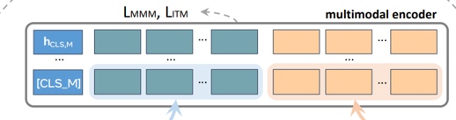

Flava Model - Multimodal Encoder
A separate transformer is used to fuse the image and text hidden states:
Two learned linear projections are applied over each hidden state vector in $\{h_{I}\}$ and $\left\{h_{T}\right\}.$
These projections are concatenated into a single list with an additional $[CLS_M]$ token added.
This concatenated list is fed into the multimodal encoder transformer (also based on the ViT architecture), allowing cross-attention between the projected unimodal image and text representations and fusing the two modalities.
The output from the multimodal encoder is a list of hidden states $\left\{h_{M}\right\}$, each corresponding to a unimodal vector from $\{h_{I}\}$ or $\{h_{T}\}$ (and a vector $h_{CLS,M}$ for $[CLS_M]$).

Slide 15

Attention
The transformer building blocks are scaled dot-product attention units.
When a sentence is passed into a transformer model, attention weights are calculated between every token simultaneously.
The attention unit produces embeddings for every token in context that contain information about the token itself along with a weighted combination of other relevant tokens each weighted by its attention weight.
$$Attention\left(Q,K,V\right)=softmax\left(\frac{QK^{T}}{\sqrt{d_{k}}}\right)V$$

Slide 16

Multi-head Attention
One set of $\left(W_{Q},W_{K},W_{V}\right)$ matrices is called an attention head, and each layer in a transformer model has multiple attention heads.
While each attention head attends to the tokens that are relevant to each token, with multiple attention heads the model can do this for different definitions of "relevance". In addition the influence field representing relevance can become progressively dilated in successive layers.

Slide 17

Transformer
Like earlier seq2seq models, the original Transformer model used an encoder-decoder architecture.
The encoder consists of encoding layers that process the input iteratively one layer after another
The decoder consists of decoding layers that process the hidden state iteratively
The function of each encoder layer is to generate encodings that contain information about which parts of the inputs are relevant to each other. It passes its encodings to the next encoder layer as inputs.
Each decoder layer does the opposite, taking all the encodings and using their incorporated contextual information to generate an output sequence. To achieve this, each encoder and decoder layer makes use of an attention mechanism.

Slide 18
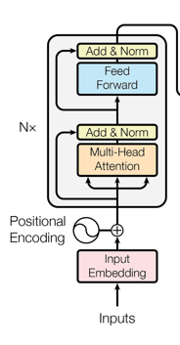
Encoder
Each encoder consists of two major components:
a self-attention mechanism, which accepts input encodings from the previous encoder and weighs their relevance to each other to generate output encodings.
a feed-forward neural network, which further processes each output encoding individually, which are then passed to the next encoder as its input, as well as to the decoders.
The first encoder takes positional information and embeddings of the input sequence as its input, rather than encodings. The positional information is necessary for the transformer to make use of the order of the sequence, because no other part of the transformer makes use of this.

Slide 19
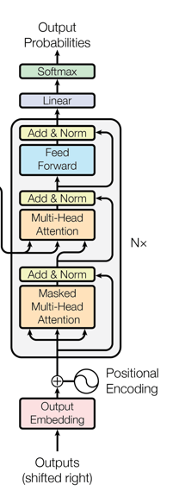
Decoder
Each decoder consists of three major components: a
self-attention mechanism
an attention mechanism over the encodings
and a feed-forward neural network.
The decoder functions in a similar fashion to the encoder, but an additional attention mechanism is inserted which instead draws relevant information from the encodings generated by the encoders.
Like the first encoder, the first decoder takes positional information and embeddings of the output sequence as its input, rather than encodings.
The transformer must not use the current or future output to predict an output, so the output sequence must be partially masked to prevent this reverse information flow. The last decoder is followed by a final linear transformation and softmax layer, to produce the output probabilities over the vocabulary.

Slide 20
Transformer vs CNN
Inductive bias

Slide 21
Background – Pretraining/Fine Tuning
Pretraining/Fine-tuning work as follows:
You have a machine learning model m
Pre-training: You have a dataset A on which you train m
You have a dataset B. Before you start training the model, you initialize some of the parameters of m with the model which is trained on A.
Fine-tuning: You train m on B.
This is one form of transfer learning, so you can transfer some of the knowledge obtained on dataset A to dataset B.

Slide 22
Pretraining Objectives
Pretraining objectives aim to obtain strong representations through pretraining on both multimodal data (paired image and text) as well as unimodal data (unpaired images or text).
Unimodal pretraining objectives:
Masked Image Modeling (MIM)
Masked Language Modeling (MLM)
Encoder initialization from unimodal pretraining
2. Multimodal pretraining objectives:
Global Contrastive Loss (GC Loss) Contrastive Multimodal
Image-text matching (ITM)
Masked multimodal modeling (MMM)
3. Joint unimodal and multimodal training
Joint Multimodal

Slide 23
FLAVA MODEL PRETRAINING
During pretraining:
masked image modeling (MIM) and mask language modeling (MLM) losses are applied onto the image and text encoders over a single image or a text piece, respectively
contrastive, masked multimodal modeling (MMM), and image-text matching (ITM) loss are used over paired image-text data.

Slide 24
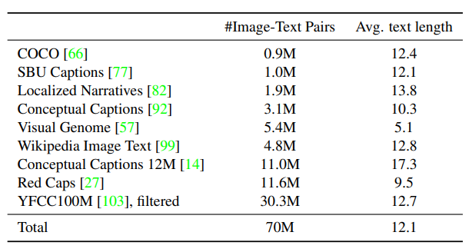
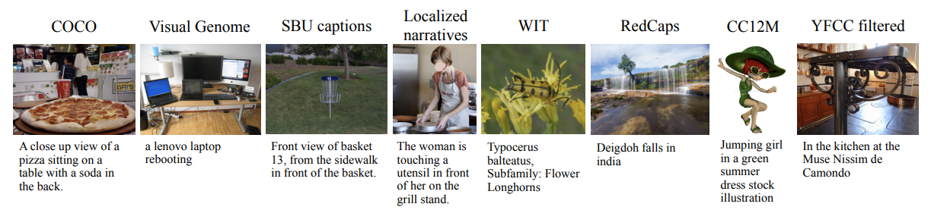
UNIMODAL AND Multimodal Training Data
Tree sources of data for pretraining:
unimodal image data (ImageNet-1K), spans 1000 object classes and contains 1,281,167 training images, 50,000 validation images and 100,000 test images.
unimodal text data (CCNews - 708241 English language news articles- and BookCorpus - 11,038 books (around 74M sentences and 1G words) of 16 different sub-genres ).
multimodal image-text paired data.
Fig: Public Multimodal Datasets (PMD)
corpus used in FLAVA multimodal pretraining,
which consists of publicly available datasets
with a total size of 70M image and text pairs. l
Fig: Representative examples from various subsets
of the multimodal pretraining dataset

Slide 25
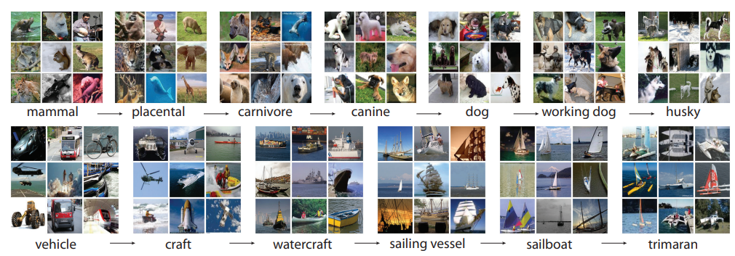
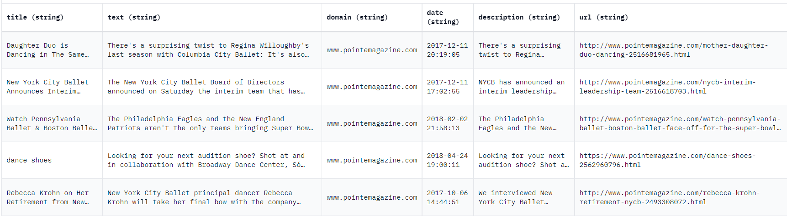
UNIMODAL AND Multimodal Training Data
Figure: A snapshot of two root-to-leaf branches of ImageNet: the top row is from the mammal subtree;
the bottom row is from the vehicle subtree.
Figure: A snapshot of the CCNews dataset

Slide 26
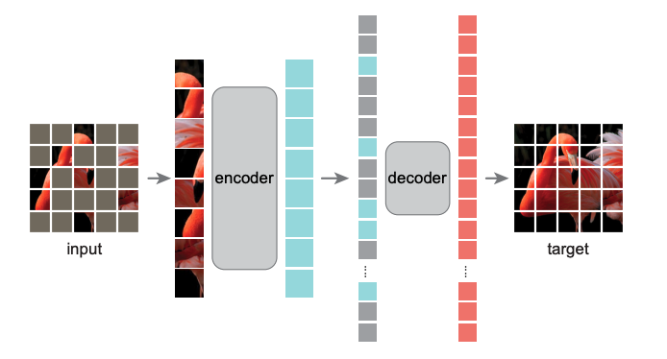
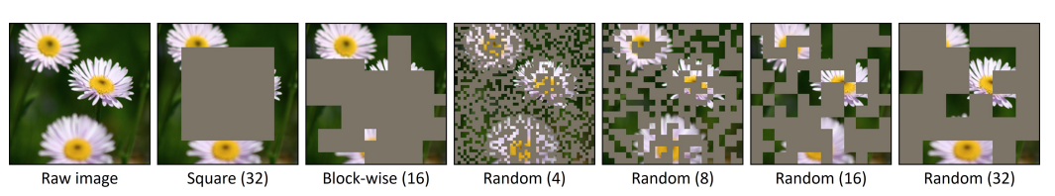

Unimodal Objectives - Masked Image Modeling (MIM)
“On unimodal image datasets, we mask a set of image patches following the rectangular block-wise masking in BEiT and reconstruct them from other image patches.
The input image is first tokenized using a pretrained dVAE tokenizer and then a classifier is applied on the image encoder outputs $\{h_{I}\}$ to predict the dVAE tokens of the masked patches.”

Slide 27
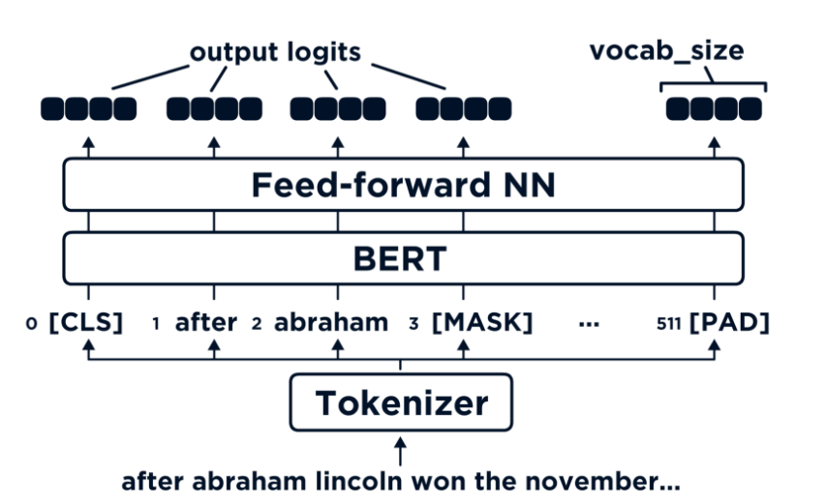

Unimodal Objectives - Masked Language Modeling (MLM)
“We apply a masked language modeling loss on top of the text encoder to pretrain on stand-alone text datasets. A fraction (15%) of the text tokens are masked in the input, and reconstructed from the other tokens using a classifier over the unimodal text hidden states output $\{h_{T}\}$.”

Slide 28
Unimodal Objectives - Encoder initialization from unimodal pretraining
“We first pretrain the text encoder with the MLM objective on the unimodal text dataset.
We pretrain the image encoder on unpaired image datasets with either MIM or the DINO objective, before joint training on both unimodal and multimodal datasets. We empirically found the DINO objective to work quite well, despite the switch to an MIM objective on images post-initialization.
Initialize the model from pretrained self-supervised weights for both vision and language encoders:
For vision encoder, we initialize from an off-the-shelf DINO model pretrained on ImageNet-1k.
For the language encoder, we pretrain a ViT model with MLM loss on CCNews and BookCorpus datasets and use its model weights.
We always initialize the multimodal encoder randomly for pretraining. “

Slide 29
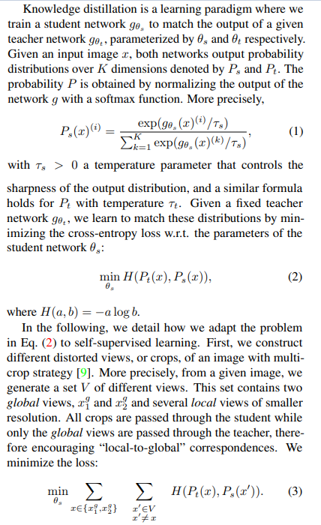
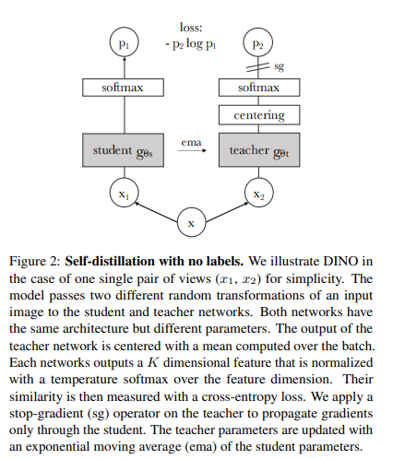

DINO Objective
DINO works by interpreting self-supervision as a special case of self-distillation, where no labels are used at all. A student network is trained by simply matching the output of a teacher network over different views of the same image.
Figures: Knowledge Distillation

Slide 30
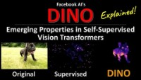

Slide 31
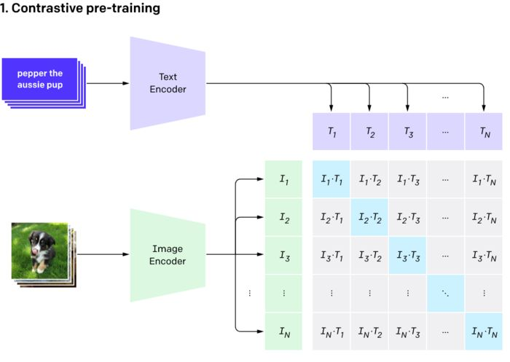

CROSS Multimodal Objectives - Global contrastive (GC) loss
“Our image-text contrastive loss resembles that of CLIP.
Given a batch of images and text, we maximize the cosine similarities between matched image and text pairs and minimize those for the unmatched pairs. This is accomplished by linearly projecting each $h_{CLS,I}$ and $h_{CLS,T}$into an embedding space, followed by L2-normalization, dot-product, and a softmax loss scaled by temperature.
Large models are often trained using multiple GPUs data parallelism, where the samples in a batch are split across GPUs. When gathering embeddings for the image and text contrastive objective, the open-source CLIP implementation only back-propagates the gradients of the contrastive loss to the embeddings from the local GPU where the dot-product is performed.
In contrast, through experiments that can be found in the supplemental, we observe a noticeable performance gain by performing full backpropagation across GPUs compared to only doing backpropagation locally. We call our loss “global contrastive” LGC to distinguish it from “local contrastive” approaches.”

Slide 32
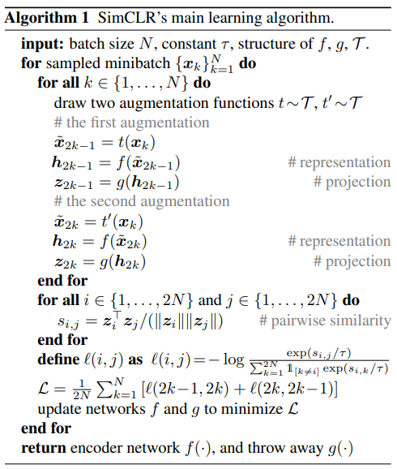
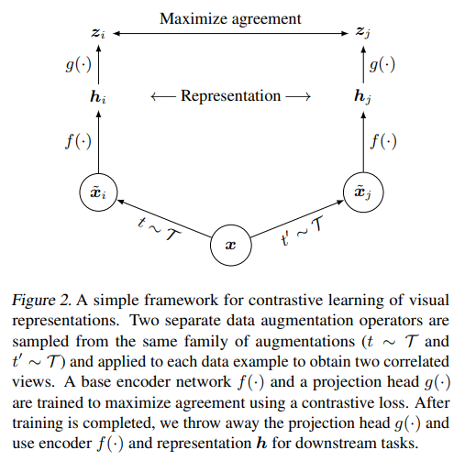
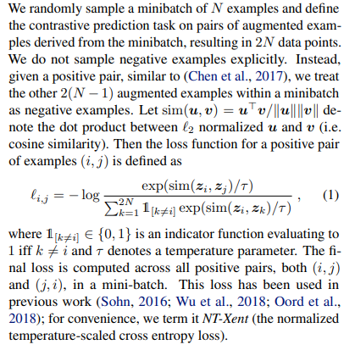
CROSS Multimodal Objectives –Global contrastive (GC) loss
Figures: CLIP Global Contrastive Loss

Slide 33
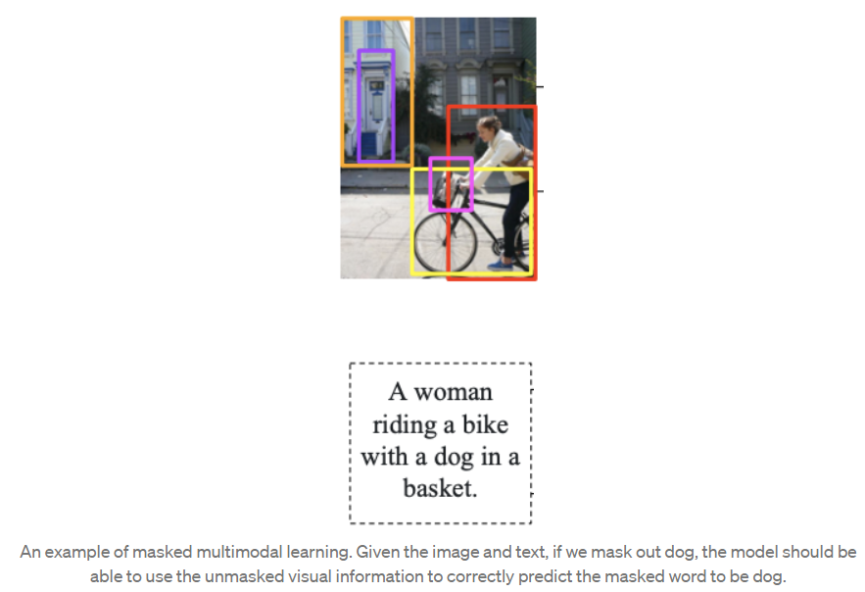
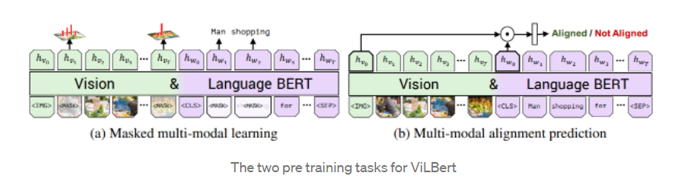
JOINT Multimodal Objectives – MMM VS Multimodal Alignment
For example, ViLBert pretrains on both of the following training objectives:
Masked multimodal modeling: Mask input image and word tokens. For the image, the model tries to predict a vector capturing image features for the corresponding image region, while for text, it predicts the masked text based on the textual and visual clues.
Multimodal alignment: Whether the image and text pair are actually from the same image and caption pair.

Slide 34
JOINT Multimodal Objectives - Masked multimodal modeling (MMM)
“While a number of previous vision-and-language pretraining approaches have focused on masked modeling of the text modality by reconstructing masked tokens from the multimodal input, most of them do not involve masked learning on image modality directly at the image pixel level in an end-to-end manner.
Here, we introduce a novel masked multimodal modeling (MMM) pretraining objective LMMM that masks both the image patches and the text tokens and jointly works on both modalities.
Specifically, given an image and text input, we first tokenize the input image patches using a pretrained dVAE (Discrete Variable Auto-Encoder) tokenizer, which maps each image patch into an index in a visual codebook similar to a word dictionary
Then, we replace a subset of image patches based on rectangular block image regions following BEiT and 15% of text tokens following BERT with a special [MASK] token.
Then, from the multimodal encoder’s output {hM}, we apply a multilayer perceptron to predict the visual codebook index of the masked image patches, or the word vocabulary index of the masked text tokens. “

Slide 35
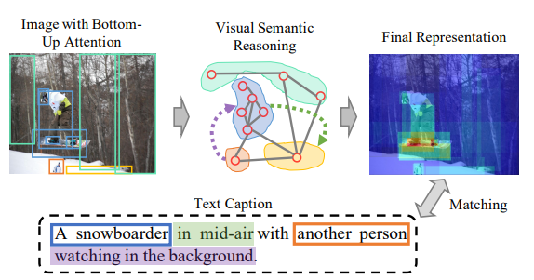

JOINT Multimodal Objectives - Image-text matching (ITM) Alingment
“Finally, we add an image-text matching loss LITM following prior vision-and-language pretraining literature. During pretraining, we feed a batch of samples including both matched and unmatched image-text pairs. Then, on top of $h_{CLS,M}$ from the multimodal encoder, we apply a classifier to decide if an input image and text match each other.”
Notes:
Image-text matching is one of the fundamental topics in this field, which refers to measuring the visual semantic similarity between a sentence and an image.
It has been widely adopted to various applications such as the retrieval of text descriptions from image queries or image search for given sentences.
Although a lot of progress has been achieved in this area, it is still a challenge problem due to the huge visual semantic discrepancy.
When people describe what they see in the picture using natural language, it can be observed that the descriptions will not only include the objects, salient stuff, but also will organize their interactions, relative positions and other high-level semantic concepts.

Slide 36
Joint unimodal and multimodal training
“After unimodal pretraining of the image and text encoders, we continue training the entire FLAVA model jointly on the three types of datasets with round-robin sampling. In each training iteration:
we choose one of the datasets according to a sampling ratio that we determine empirically and obtain a batch of samples.
depending on the dataset type. we apply unimodal MIM on image data, unimodal MLM on text data, or the multimodal losses (contrastive, MMM, and ITM) on image-text pairs.”

Slide 37
RECAP: FLAVA MODEL
Unimodal pretraining objectives:
Masked Image Modeling (MIM)
Masked Language Modeling (MLM)
Encoder initialization from unimodal pretraining
Multimodal pretraining objectives:
Global Contrastive Loss (GC Loss) Contrastive Multimodal
Image-text matching (ITM)
Masked multimodal modeling (MMM)

Slide 38
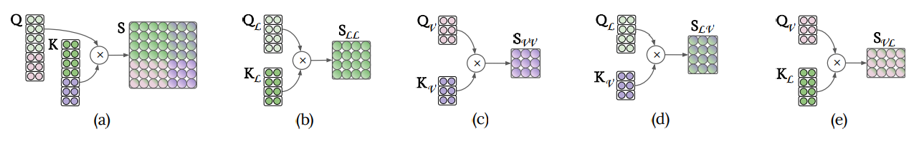
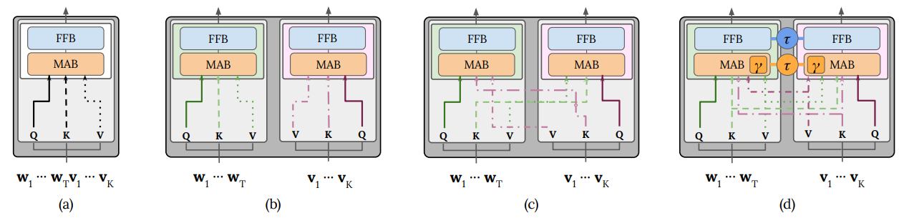
Other Models
Figure : Visualization of the score matrix for (a) single-stream, (b) text–text, (c) vision–vision, (d) text–vision, and (e) vision–text interactions. Shades of green denote the text modality, while purple ones denote the vision modality. Dual-stream scores are sub-matrices of the single-stream scores matrix
Generally, models in the vision-and-language space can be divided into two categories:
dual encoders where the image and text are encoded separately followed by a shallow interaction layer for downstream tasks ;
fusion encoder(s) with self-attention spanning across the modalities
The dual encoder approach works well for unimodal and cross-modal retrieval tasks but their lack of fusion usually causes them to underperform on tasks that involve visual reasoning and question answering which is where models based on fusion encoder(s) shine.
Figure: Visualization of the (a) single-stream, (b) dual-stream intra-modal and (c) dual-stream intermodal
Transformer layers. (d) gated bimodal layer. The inter-modal layer attends across modalities, while the intra-model layer attends within each modality. Gated bimodal can attend to either or both.

Slide 39
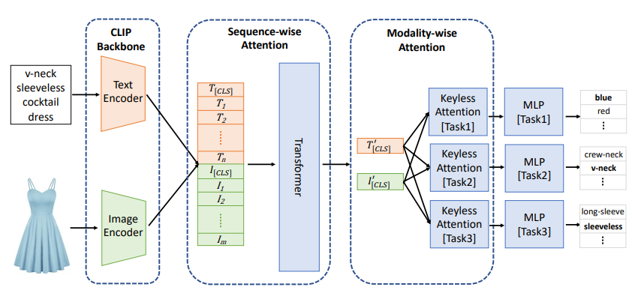
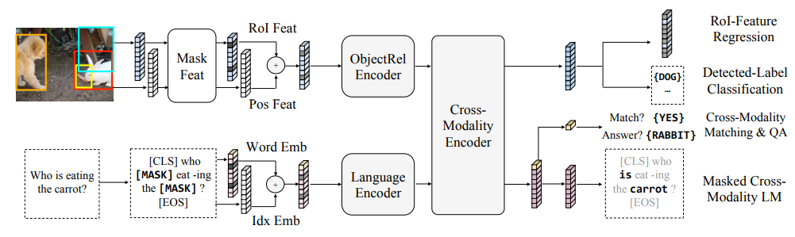
Other Models
Within the fusion encoder category, a further distinction can be made as to whether the model
uses a single transformer for early and unconstrained fusion between modalities (e.g., VisualBERT, UNITER, VLBERT, OSCAR).
allows cross-attention only in specific co-attention transformer layers while having some modality specific layers (e.g., LXMERT, ViLBERT, ERNIE-ViL).
Another distinguishing factor between different models lies in the image features that are used, ranging from region features , to patch embeddings, to convolution or grid features.
Figure: LXMERT Model
Figure: CLIP Model

Slide 40
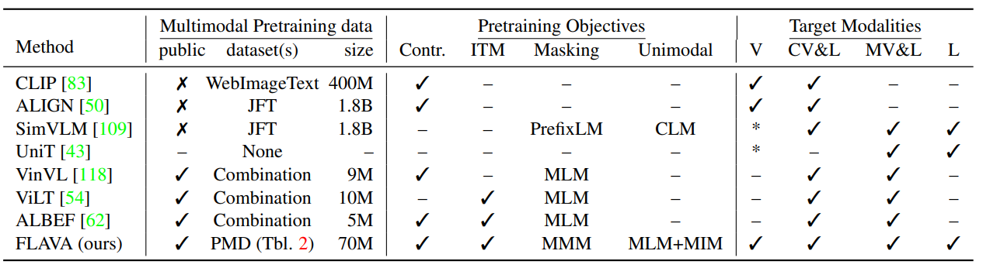
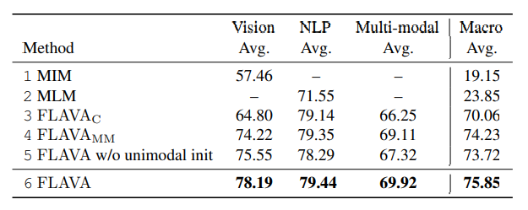

Other Models & Pretraining Comparision
Table: Comparison of recent models in different modalities.
CV&L and MV&L stands for cross-modal and multi-modal vision-and-language. * means the modality is partially targeted
Table: baselines and different ablation settings of
FLAVA, including: models trained with unimodal MIM
and MLM losses, ${FLAVA}_{C}$ trained with only image-text
contrastive loss, ${FLAVA}_{MM}$ trained only on multimodal data models without unimodal initialization, and the full model

Slide 41
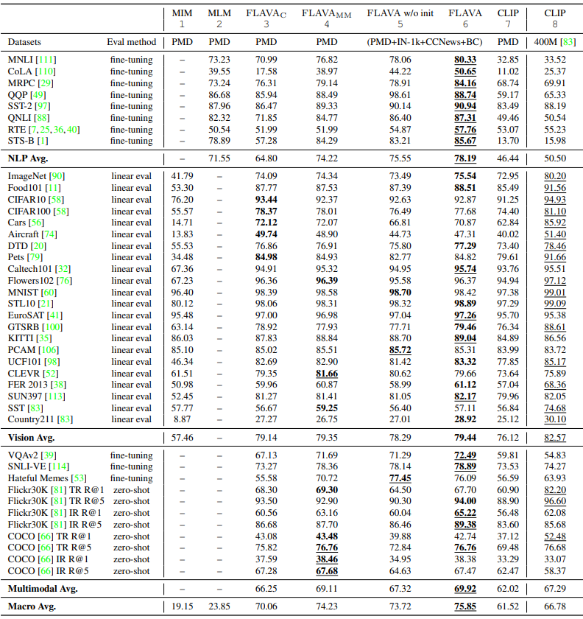
FLAVA VS CLIP
FLAVA works significantly better on language and multimodal tasks while slightly worse than CLIP on some vision-only tasks.
In addition, we note that FLAVA outperforms the variant of the CLIP model pretrained only on the PMD dataset.
Table: Comparing full FLAVA pretraining with other settings, where FLAVA gets the highest macro average score.

Slide 42
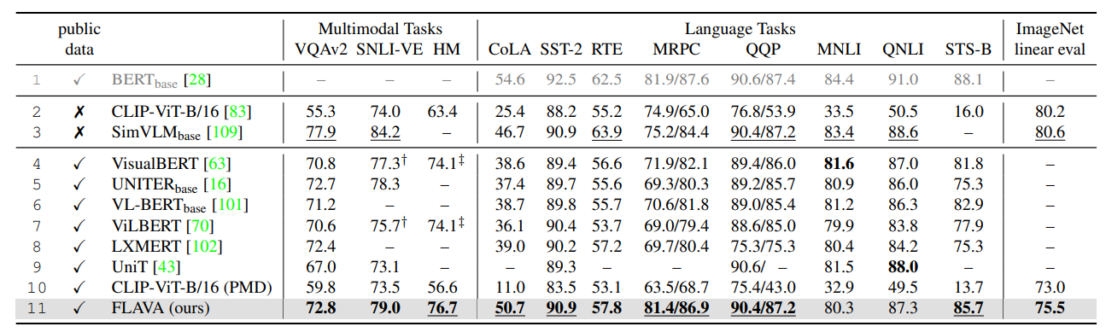
FLAVA VS State-oF-THE-ART
FLAVA largely outperforms previous multimodal approaches pretrained on public data (row 4 to 11)
on both language and multimodal tasks and approaches the well-established BERT model on several
GLUE benchmark tasks.

Slide 43

Conclusions
FLAVA is transferable to a great number of tasks in vision, language, and multimodality.
FLAVA leaverages other previous models’ knowledge such as the DINO objectivo CLIP’s contrastive loss or the ViT model.
FLAVA uses a simple architecture based on the ViT-16 vision transformer, which present less inductive bias than other models such as CNNs.
FLAVA uses cross-modal, joint multimodal and unimodal pre-training to learn more generic representations and achieve better results. Previous models do not use all of these objectives simultaneously.
FLAVA largely outperforms previous multimodal approaches pretrained on public data on both language and multimodal tasks and approaches the well-established BERT model on several GLUE benchmark tasks.

Slide 44
References
Singh, Amanpreet, et al. "FLAVA: A Foundational Language And Vision Alignment Model." arXiv preprint arXiv:2112.04482 (2021).
Li, Kunpeng, et al. "Visual semantic reasoning for image-text matching." Proceedings of the IEEE/CVF International conference on computer vision. 2019.
Xie, Zhenda, et al. "Simmim: A simple framework for masked image modeling." arXiv preprint arXiv:2111.09886 (2021).
https://towardsdatascience.com/masked-language-modelling-with-bert-7d49793e5d2c
https://github.com/topics/masked-image-modeling
https://medium.com/georgian-impact-blog/how-to-incorporate-tabular-data-with-huggingface-transformers-b70ac45fcfb4
Chen, Ting, et al. "A simple framework for contrastive learning of visual representations." International conference on machine learning. PMLR, 2020.

Slide 45
Thank YOU!

